Slide 1
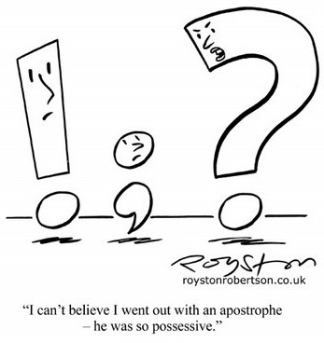
AGREEMENT
Check for Understanding
Some info on these slides is from: https://owl.purdue.edu/owl/general_writing/grammar/subject_verb_agreement.html
Notes:
‹#›

Slide 2
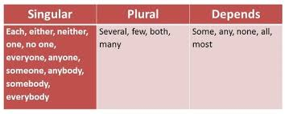
5 min video clip providing an overview of the TRICKY nature of subject / verb agreement and subject / pronoun
CLICK HERE for the VIDEO

Slide 3
each, each one, either, neither, everyone, everybody, anybody, anyone, nobody, somebody, someone, and no one are singular and require a pronoun and a singular verb.
Each of the teachers is offering extra credit in his or her class for volunteering at the event.

Slide 4
How does AND / OR affect agreement?
When the subject of a sentence is composed of two or more nouns or pronouns connected by and, use a plural verb.
She and her friends are at the fair
.
When two or more singular nouns or pronouns are connected by or or nor, use a singular verb.
The book or the pen is in the drawer.
Notes:
‹#›

Slide 5
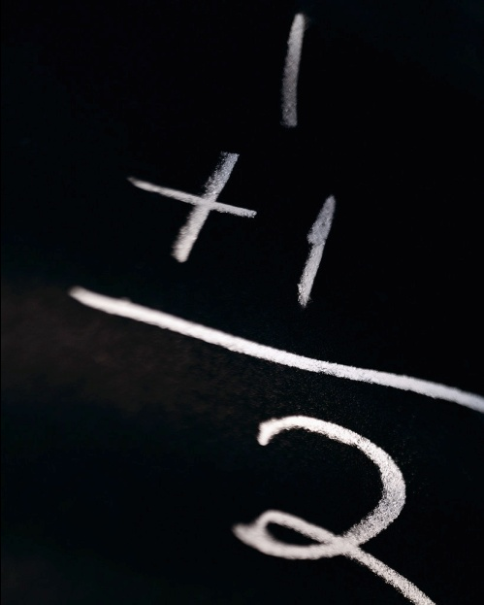
When AND is in a subject, the subject is ALWAYS PLURAL
A) TRUE
B) FALSE
Notes:
🍐 This is a Pear Deck Multiple Choice Slide. Your current options are: A: True, B: False,
🍐 To edit the type of question or choices, go back to the "Ask Students a Question" in the Pear Deck sidebar.

Slide 6
A) TRUE

Slide 7
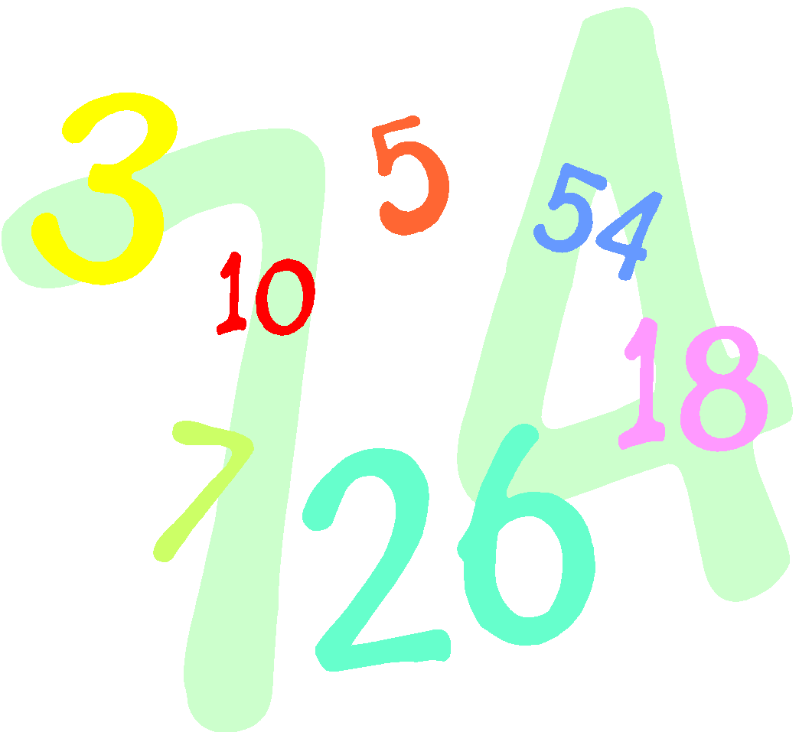
Everyone, anyone, someone, nobody, each, much, one, neither, and either are considered plural
A)True
B) False
Notes:
🍐 This is a Pear Deck Multiple Choice Slide. Your current options are: A: True, B: False,
🍐 To edit the type of question or choices, go back to the "Ask Students a Question" in the Pear Deck sidebar.

Slide 8
B) False – they are considered singular – even if you say EACH of the KIDS – it’s still singular
Everyone needs to bring HIS or HER own lunch.
NOT
Everyone needs to bring their lunch.

Slide 9
If anyone doesn’t like this music, ___________ can go somewhere else.
A) they
B)he or she
Notes:
🍐 This is a Pear Deck Multiple Choice Slide. Your current options are: A: they, B: he or she,
🍐 To edit the type of question or choices, go back to the "Ask Students a Question" in the Pear Deck sidebar.

Slide 10
B) He or she
Singular because of the word anyone

Slide 11
Each of the dogs needs______ collar.
A) its
B) their
Notes:
🍐 This is a Pear Deck Multiple Choice Slide. Your current options are: A: its, B: their,
🍐 To edit the type of question or choices, go back to the "Ask Students a Question" in the Pear Deck sidebar.

Slide 12
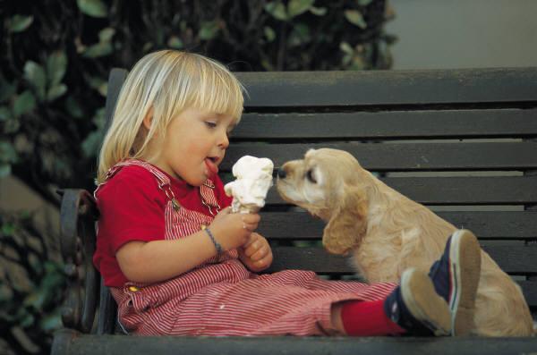
A) Its EACH makes it singular even though it says DOGS

Slide 13
Subjects joined with OR can be more TRICKY
When a compound subject contains both a singular and a plural noun or pronoun joined by or or nor, the verb should agree with the part of the subject that is nearer the verb.
The boy or his friends run every day.
His friends or the boy runs every day.
Notes:
‹#›

Slide 14
Either the doctors OR the chief administrator ___________ going to have to make a decision
A) IS
B) ARE
Notes:
🍐 This is a Pear Deck Multiple Choice Slide. Your current options are: A: is, B: are,
🍐 To edit the type of question or choices, go back to the "Ask Students a Question" in the Pear Deck sidebar.

Slide 15
IS (singular)
This sentence had OR in the subject and the item closest to the verb was singular so we need a singular verb
Either the doctors OR the chief administrator ___________ going to have to make a decision

Slide 16
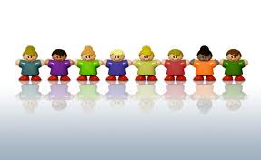
Each of the boys needs to bring ________ sleeping bag.
His
Their
Notes:
🍐 This is a Pear Deck Multiple Choice Slide. Your current options are: A: his, B: their,
🍐 To edit the type of question or choices, go back to the "Ask Students a Question" in the Pear Deck sidebar.

Slide 17
A) His (singular)
Even though it says BOYS it’s singular because of the word EACH

Slide 18
When OR is used in a subject, the subject is always singular.
TRUE
FALSE
Notes:
🍐 This is a Pear Deck Multiple Choice Slide. Your current options are: A: true, B: false,
🍐 To edit the type of question or choices, go back to the "Ask Students a Question" in the Pear Deck sidebar.

Slide 19
B) FALSE
If both are singular = singular
IF both are plural = plural
If one is sing. and one is plural = the one CLOSEST to the verb determines # (sing. or plural)

Slide 20
There’s subject / pronoun agreement but there is also
SUBJECT/VERB AGREEMENT
Notes:
‹#›

Slide 21
Plural and Singular VERBS
Verbs are opposite of nouns because we make them SINGULAR by ADDING an S

Slide 22
each, each one, either, neither, everyone, everybody, anybody, anyone, nobody, somebody, someone, and no one are singular and require a singular verb.
Each of these hot dogs is juicy.
Everybody knows Mr. Jones.
Either is correct.

Slide 23
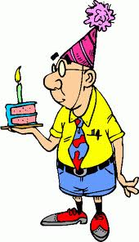
____________my brother OR my sisters going to pick out Dad’s birthday cake?
A) IS
B) ARE
Notes:
🍐 This is a Pear Deck Multiple Choice Slide. Your current options are: A: Is, B: Are,
🍐 To edit the type of question or choices, go back to the "Ask Students a Question" in the Pear Deck sidebar.

Slide 24
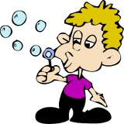
A) IS (singular)
Again OR is used and the part of the subject closest to the verb is singular so we need a singular verb.
_____IS______my brother OR my sisters going to pick out Dad’s birthday cake?

Slide 25
Some of the votes _________ to have been miscounted.
A) Seem
B) Seems
Notes:
🍐 This is a Pear Deck Multiple Choice Slide. Your current options are: A: seem, B: seems,
🍐 To edit the type of question or choices, go back to the "Ask Students a Question" in the Pear Deck sidebar.

Slide 26
A) Seem (plural)
When using the word SOME we use plural verbs if the item (votes) is countable
VOTES is plural so we need a Plural Verb
Remember verbs are opposite of nouns. We make them SINGULAR by adding an S

Slide 27
Do not be misled by a phrase that comes between the subject and the verb. The verb agrees with the subject, not with a noun or pronoun in the phrase.
One of the boxes is open.
The people who listen to that music are few.
The team captain, as well as his players, is anxious.
The book, including all the chapters in the first section, is boring.

Slide 28
The tornadoes that tear through the county every spring ____ destructive.
A) are
B) is
Notes:
🍐 This is a Pear Deck Multiple Choice Slide. Your current options are: A: are, B: is,
🍐 To edit the type of question or choices, go back to the "Ask Students a Question" in the Pear Deck sidebar.

Slide 29
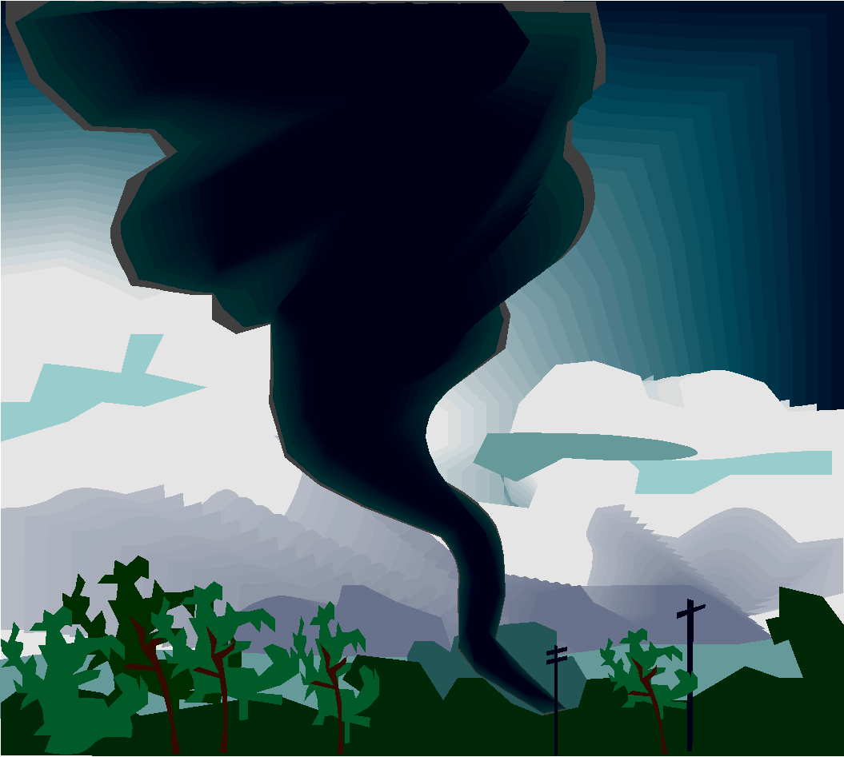
B) ARE
TORNADOS is the subject
Don’t be distracted by the phrase that comes after it (i.e. that tear through the county)

Slide 30
Everyone selected for the jury ______ to be unbiased.
Have
Has
Notes:
🍐 This is a Pear Deck Multiple Choice Slide. Your current options are: A: have, B: has,
🍐 To edit the type of question or choices, go back to the "Ask Students a Question" in the Pear Deck sidebar.

Slide 31
B) HAS
Everyone is considered singular

Slide 32
Tim, together with his teammates, ______________a tough opponent.
A) presents
B) present
Notes:
🍐 This is a Pear Deck Multiple Choice Slide. Your current options are: A: presents, B: present,
🍐 To edit the type of question or choices, go back to the "Ask Students a Question" in the Pear Deck sidebar.

Slide 33
A) presents
Don’t be distracted by the phrase that comes after the word Tim.
Also remember that VERBS that end w/ S are singular
Tim, together with his teammates, ____IS_____a tough opponent.

Slide 34
One of the students must give _______ presentation tomorrow.
A)THEIR
B) HIS
Notes:
🍐 This is a Pear Deck Multiple Choice Slide. Your current options are: A: their, B: his,
🍐 To edit the type of question or choices, go back to the "Ask Students a Question" in the Pear Deck sidebar.

Slide 35
B) HIS
Even though it says STUDENTS, it is singular because of the word ONE
One of the students is

Slide 36
All of the students brought _______ homework.
A)His or her
B)Their
Notes:
🍐 This is a Pear Deck Multiple Choice Slide. Your current options are: A: his or her, B: their,
🍐 To edit the type of question or choices, go back to the "Ask Students a Question" in the Pear Deck sidebar.

Slide 37
B) THEIR - all is ALWAYS plural

Slide 38
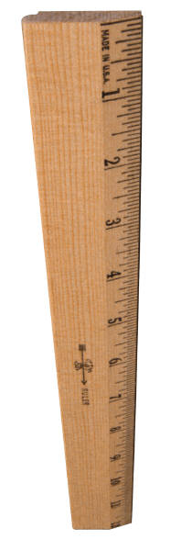
He is taller than ________.
I
Me
Notes:
🍐 This is a Pear Deck Multiple Choice Slide. Your current options are: A: I, B: me,
🍐 To edit the type of question or choices, go back to the "Ask Students a Question" in the Pear Deck sidebar.

Slide 39
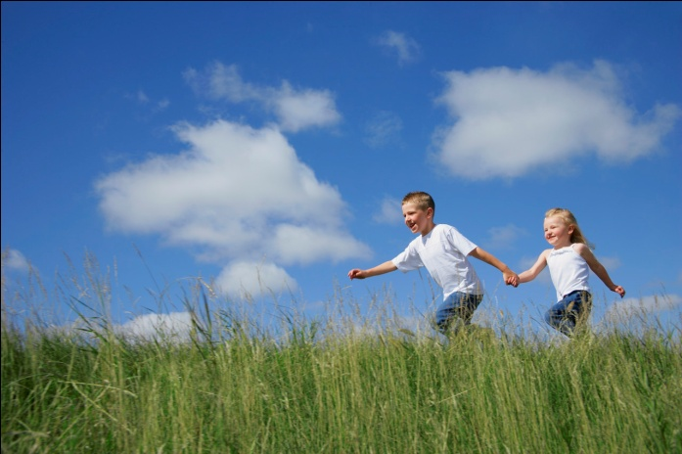
I -- Are you surprised?
For a comparison you need to finish the sentence. He is taller than I am.

Slide 40
THAT WAS PART One of Agreement
CLICK HERE for: AGREEMENT review and
CLICK HERE for:PESKY PRONOUNSreview
CONTINUE ON TO CHALLENGE ZONE…

Slide 41
REFLEXIVE Pronouns like myself, himself, herself and themselves
can only used to REFLECT BACK to a subject ALREADY stated

Slide 42
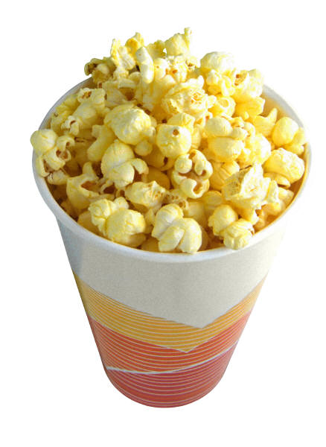
Tim and myself are going to the movies.
Correct
Incorrect
Notes:
🍐 This is a Pear Deck Multiple Choice Slide. Your current options are: A: correct, B: incorrect,
🍐 To edit the type of question or choices, go back to the "Ask Students a Question" in the Pear Deck sidebar.

Slide 43
B) INCORRECT
Myself, himself,
herself, etc. are reflexive
pronouns. Meaning they REFLECT back from a subject. You COULD say “I am going to the movie by myself.” but NOT “Tim and myself are gong to the movie”

Slide 44
She wants to do it by herself.
Correct
Incorrect
Notes:
🍐 This is a Pear Deck Multiple Choice Slide. Your current options are: A: correct, B: incorrect,
🍐 To edit the type of question or choices, go back to the "Ask Students a Question" in the Pear Deck sidebar.

Slide 45
A) Correct!
HERSELF is reflecting back to the word SHE. Therefore, it is correct.
She wants to do it herself.

Slide 46
COLLECTIVE NOUNS
A jury is singular WHEN it is acting collectively as one unit. But when individual jurors act separately then the subject is plural
Class = singular
Class members = plural
Jury = singular
Jury members = plural

Slide 47
The class will present _______ findings do the school board.
Its
Their
Notes:
🍐 This is a Pear Deck Multiple Choice Slide. Your current options are: A: its, B: their,
🍐 To edit the type of question or choices, go back to the "Ask Students a Question" in the Pear Deck sidebar.

Slide 48
A) ITS
CLASS is a collective noun. Therefore, it is considered one UNIT so it’s singular.

Slide 49
The members of the jury explained _______ reasoning.
Their
Its
Notes:
🍐 This is a Pear Deck Multiple Choice Slide. Your current options are: A: their, B: its,
🍐 To edit the type of question or choices, go back to the "Ask Students a Question" in the Pear Deck sidebar.

Slide 50
TRICKY A) THEIR
A jury is singular WHEN it is acting collectively as one unit. But when individual jurors act separately then the subject is plural
Class = singular
Class members = plural
Jury = singular
Jury members = plural

Slide 51
This is NOT meant to take the place of studying.
Go to the website for more review! CLICK HERE

